Slide 1

HOTEL CHAIN
Hotel Demand Forecast
SINCE 1930
Group 3: Jiayi Zhao, Jiachen Yu, Sen Yang, Zhi Zhang

Slide 2
HOTEL CHAIN
TABLE OF CONTENTS
·01·
·02·
·03·
·04·
·05·
·06·
SINCE 1930
PURPOSE & MOTIVATION
DATA PROCESSING
TRAIN-TEST SPLIT
STATIONARITY CHECK
METHODOLOGY & MODEL SELECTION
RESULTS & CONCLUSION

Slide 3

Executive Summary
HOTEL CHAIN
Analyzing hotel booking demand to develop predictive models for the hospitality industry. Accurate forecasting is crucial for optimizing resource allocation, maximizing occupancy, and enhancing customer experience. Through various time series and machine learning models, we found that a simple OLS regression model outperforms more complex approaches. Key features, like average daily rate (ADR) and GDP, enable reliable demand forecasts, providing valuable insights for hotel management.
SINCE 1930

Slide 4

HOTEL CHAIN
PURPOSE & MOTIVATION
·01·
SINCE 1930
This project aims to forecast hotel bookings using historical data to help hotels manage resources, refine marketing, and enhance customer experience amid fluctuating demand.
Advanced time series models capture booking patterns, providing both short-term and long-term forecasts, with rigorous test-set validation ensuring robust results.
The project demonstrates the potential of machine learning in hospitality, showcasing data analytics as a tool to improve operational efficiency and revenue management.

Slide 5

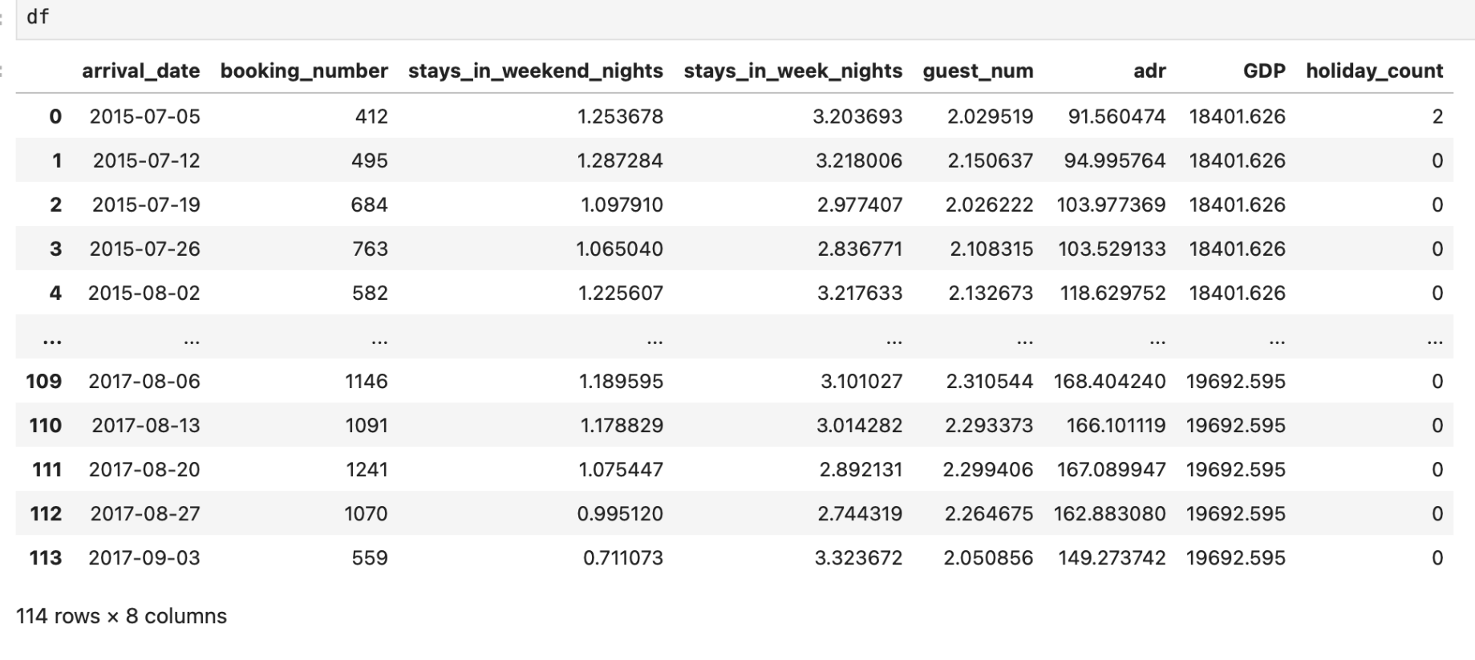
HOTEL CHAIN
·02·
DATA PROCESSING
SINCE 1930
Data Description
The dataset from Kaggle includes key hotel booking details—such as booking count, arrival date, ADR, guest numbers, GDP, and holidays—providing essential insights for analyzing demand patterns.
Data Preprocessing
Date Conversion
Guest Count Calculation
Aggregation
Integration of GDP Data
Weekly Resampling
Holiday Feature Creation

Slide 6
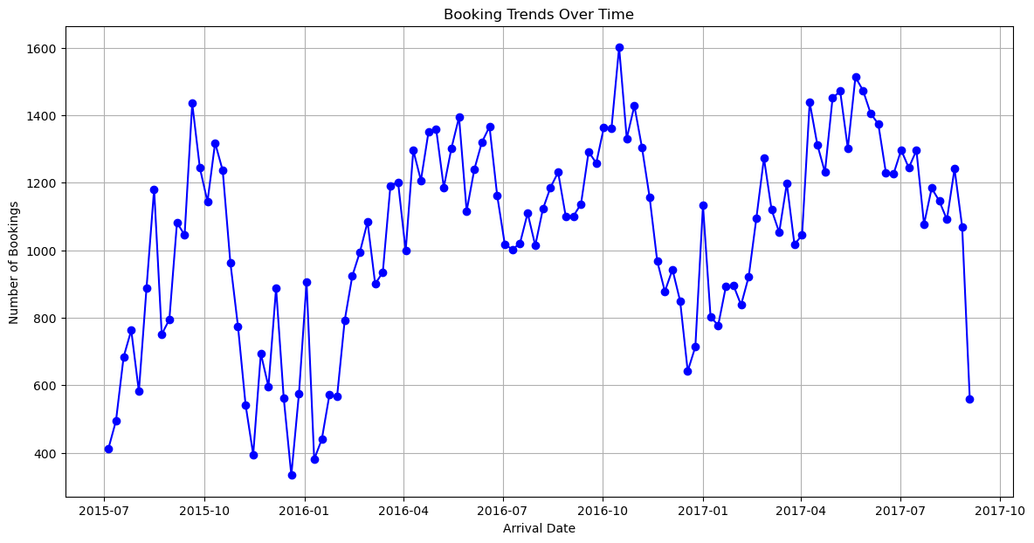
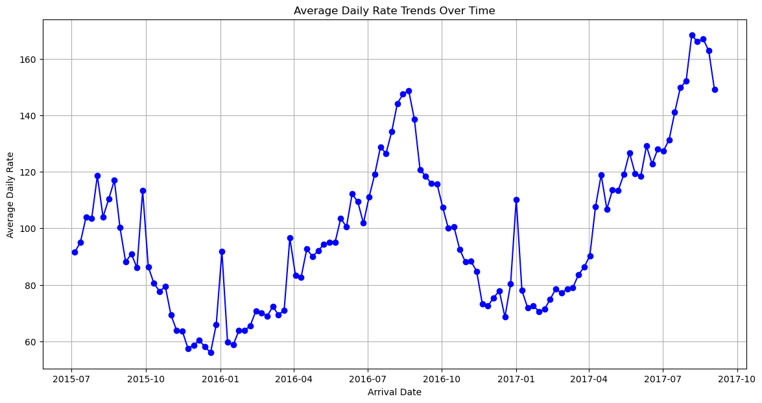
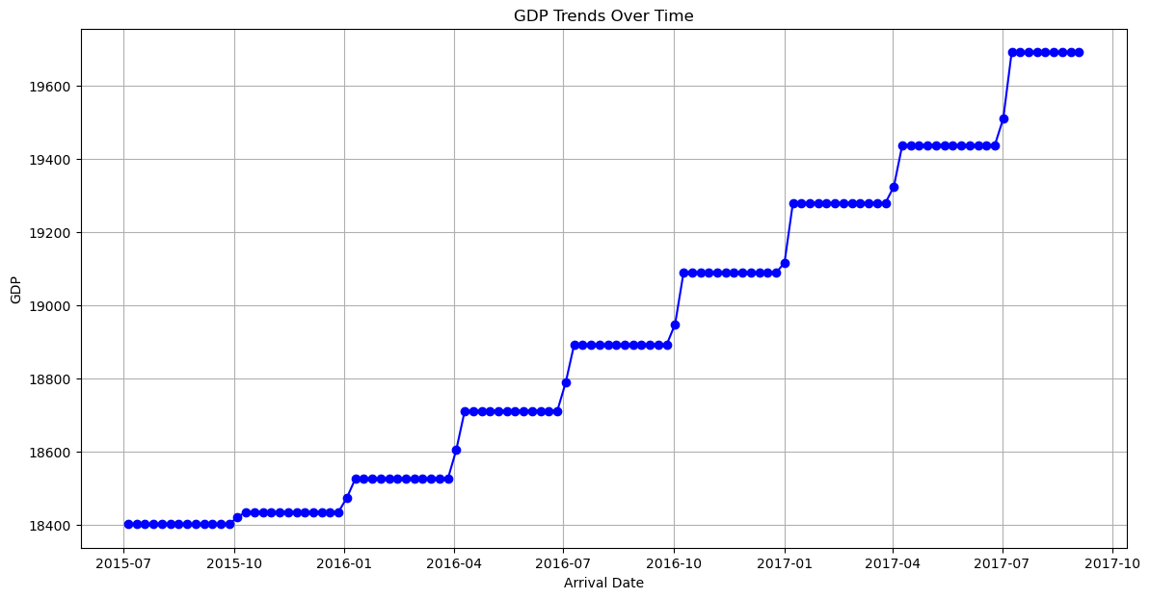
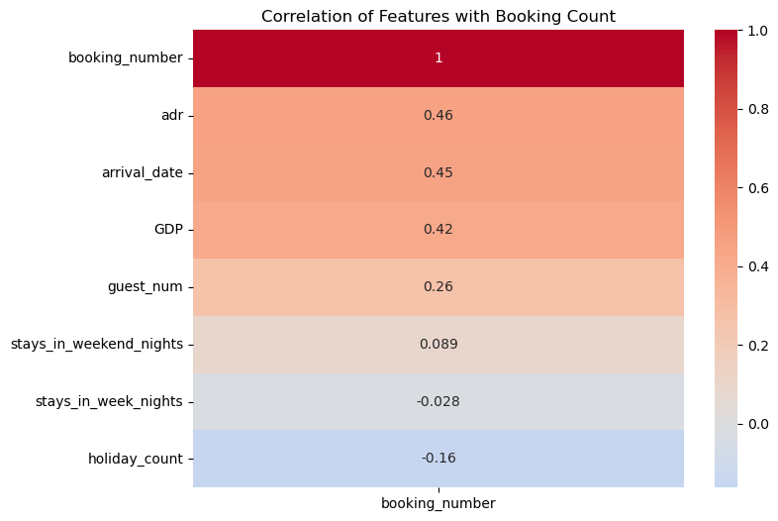
Exploratory Data Analysis (EDA)
Booking Trends Over Time
Average Daily Rate (ADR) Trends Over Time
GDP Trends Over Time
Correlation of Features with Booking Count
HOTEL CHAIN
SINCE 1930

Slide 7
·03·
TRAIN-TEST SPLIT
Data was split 80-20 chronologically to maintain temporal order for realistic model evaluation.
Training set: 2015-07-05 to 2017-04-02.
Test set: 2017-04-09 to 2017-09-03.
This setup mimics real-world conditions by testing the model on future, unseen data.
2015-07-05
2017-04-02
TRAINING
TESTING
2017-04-09
2017-09-03
HOTEL CHAIN
SINCE 1930

Slide 8

·04·
STATIONARITY CHECK
HOTEL CHAIN
We performed the Augmented Dickey-Fuller (ADF) test on each time series to assess stationarity.
Differencing: Applied to variables like booking count and ADR to remove trends and achieve a stable mean, which is essential for accurate time series forecasting.
Growth Calculation: For some features, we calculated the growth rate, providing a stabilized series that captures changes over time without absolute fluctuations.
The stationarity-adjusted series, as shown on next slide, confirm the successful transformation of key variables, with ACF plots reflecting reduced autocorrelation and stable means, which are essential for reliable model training.
SINCE 1930

Slide 9
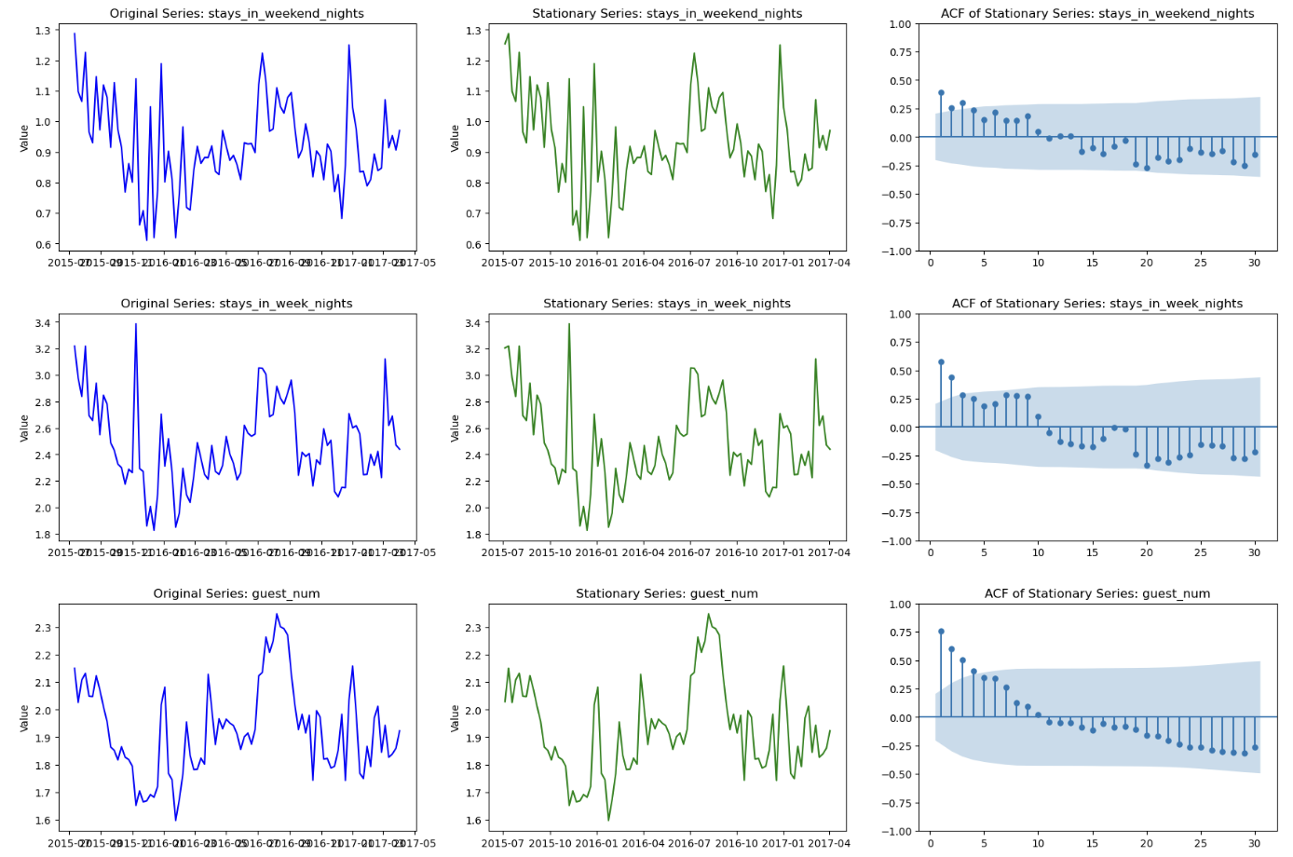
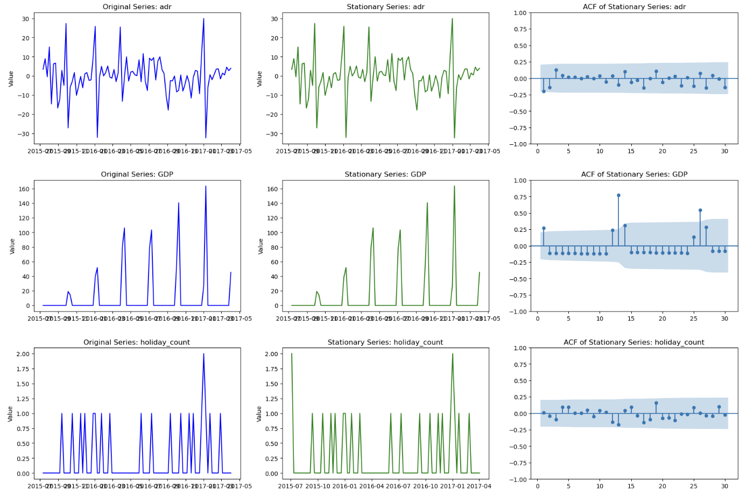
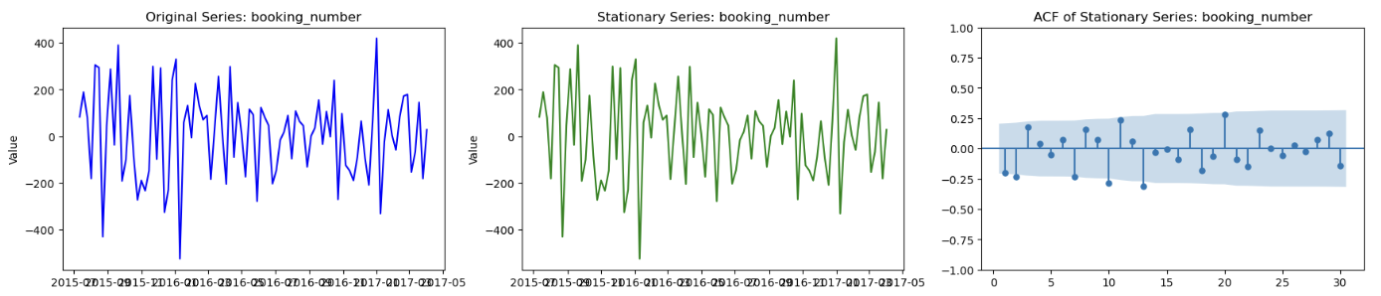
Stationarity Transformation and Autocorrelation Analysis of Time Series Variables
HOTEL CHAIN
SINCE 1930

Slide 10

·05·
METHODOLOGY &
MODEL SELECTION
HOTEL CHAIN
Ordinary Least Squares (OLS) Model
VAR Models
ARIMA Model
SINCE 1930

Slide 11
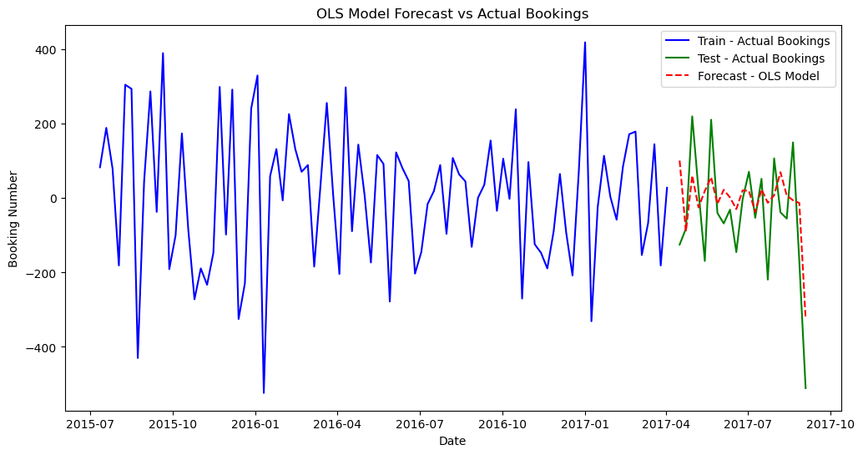
Ordinary Least Squares (OLS) Model
Approach: Simple linear regression focusing on key predictors like ADR, GDP, and holidays to capture linear trends in booking demand.
Performance: Achieved the lowest MSLE of 2.35, effectively capturing proportional demand variations.
Limitations: Struggles with seasonality and peaks, with limited R-squared of 0.143, showing low explanatory power for complex patterns.
HOTEL CHAIN
SINCE 1930

Slide 12
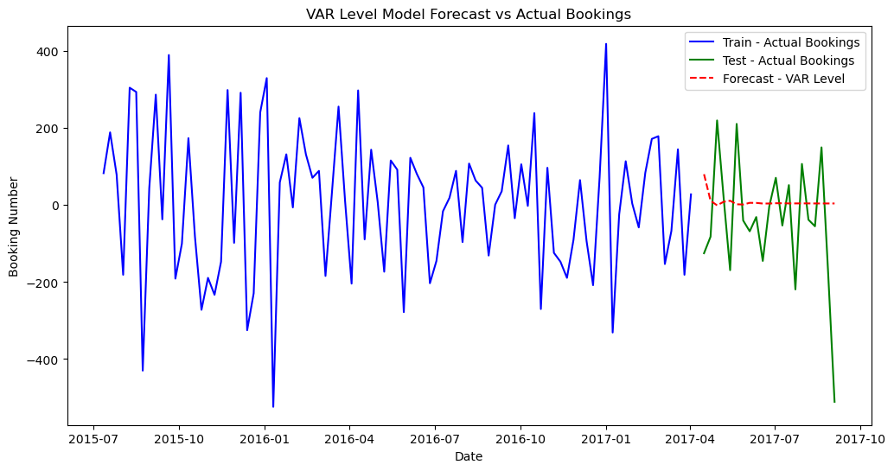
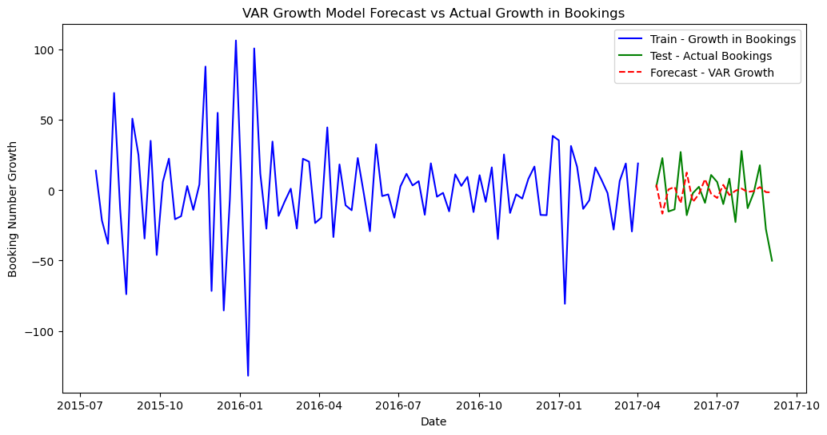
VAR Models
VAR Level Model: Uses raw levels of variables to capture interdependencies. However, a high MSLE of 12.79 indicates overfitting and difficulty predicting absolute values accurately.
VAR Growth Model: Utilizes growth rates to emphasize relative changes. Achieved a slightly better MSLE of 12.07, but still underperformed compared to OLS, failing to capture stable, linear demand trends.
HOTEL CHAIN
SINCE 1930

Slide 13
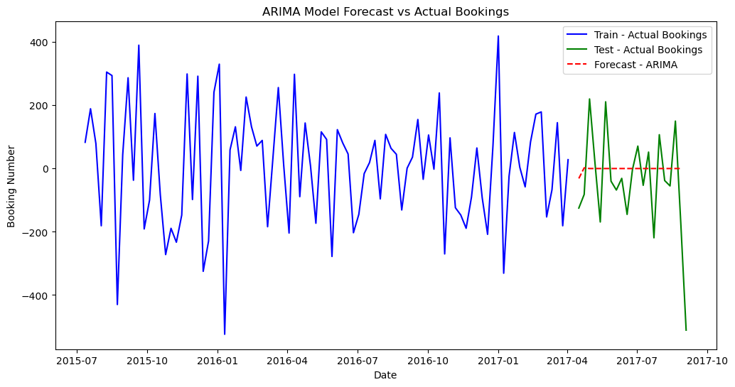
ARIMA Model
Approach: Seasonal ARIMA with auto-selected parameters to capture booking cycles.
Performance: Highest MSLE of 21.18, indicating poor fit for booking data.
Limitations: Struggled with multivariate data and reliance on past values, which limited its effectiveness in integrating external predictors like ADR and GDP.
HOTEL CHAIN
SINCE 1930

Slide 14
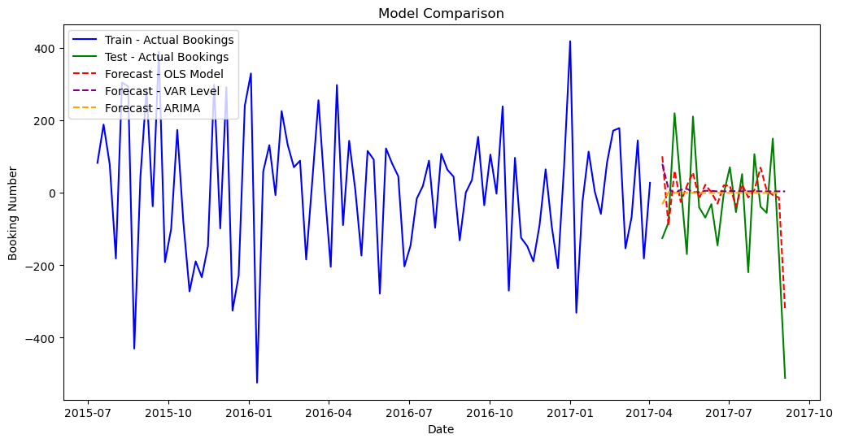
·06·
RESULTS & CONCLUSION
Among the models, the OLS model, despite its simplicity, yielded the lowest MSLE score of 2.35, indicating better alignment with test data. The ARIMA model, with an MSLE of 21.18, had the weakest performance due to its inability to account for multivariate relationships.
The implications for hotel management are significant, as a straightforward OLS model allows for easy implementation and reliable predictions, aiding in strategic staffing, inventory management, and pricing adjustments.
HOTEL CHAIN
SINCE 1930

Slide 15

HOTEL CHAIN
THANKS!
SINCE 1930
Jiayi Zhao, Jiachen Yu, Sen Yang, Zhi Zhang

